Slide 1
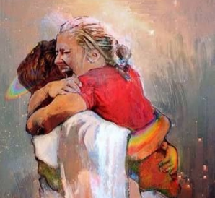
The Doctrine of Christ: The Same Yesterday, Today and Forever
-The Creation / The Fall / The Atonement
-Baptism of Fire and of the Holy Ghost
-Law/Covenant of a Broken Heart and Contrite Spirit
-Patterns of these throughout the Scriptures
-How this applies to us today
Notes:
Redemption from the Fall has been the same since Adam and Eve and cannot be bought through any other means or by any other price other than that which is laid out by Holy Prophets from the Beginning of Time and patterned throughout scripture for us to emulate in our lives today.
We’ll will review only a couple of examples of these however, you can see them in each prophets life and teachings.

Slide 2
True Baptism has two parts: Water and Fire
-Water is the carnal outward expression
-Baptism of Fire and of the Holy Ghost is the inward Spiritual redemption
Moses 6:60 For by the ªwater ye keep the commandment; by the Spirit ye are ^{b}justified, and by the ^{c}blood ye are ^{d}sanctified;
Matt 3:11-“I indeed baptize you with water unto repentance, but…he shall baptize you with the Holy Ghost, and with fire”
JST John 1:28 He it is of whom I bear record. He is that prophet, even Elias, who, coming after me, is preferred before me, whose shoe’s latchet I am not worthy to unloose, or whose place I am not able to fill; for he shall baptize, not only with water, but with fire, and with the Holy Ghost.
2 Nephi 31:13-14 Wherefore, my beloved brethren, I know that if ye shall follow the Son, with full purpose of heart, acting no hypocrisy and no deception before God, but with real intent, repenting of your sins, witnessing unto the Father that ye are willing to take upon you the name of Christ, by baptism—yea, by following your Lord and your Savior down into the water, according to his word, behold, then shall ye receive the Holy Ghost; yea, then cometh the baptism of fire and of the Holy Ghost; and then can ye speak with the tongue of angels, and shout praises unto the Holy One of Israel. 14 But, behold, my beloved brethren, thus came the voice of the Son unto me, saying: After ye have repented of your sins, and witnessed unto the Father that ye are willing to keep my commandments, by the baptism of water, and have received the baptism of fire and of the Holy Ghost, and can speak with a new tongue, 17 Wherefore, do the things which I have told you I have seen that your Lord and your Redeemer should do; for, for this cause have they been shown unto me, that ye might know the gate by which ye should enter. For the gate by which ye should enter is repentance and baptism by water; and then cometh a remission of your sins by fire and by the Holy Ghost.
Joseph Smith Taught:
“You might as well baptize a bag of sand as a man, if not done in view of the remission of sins and getting of the Holy Ghost. Baptism by water is but half a baptism, and is good for nothing without the other half﻿—that is, the baptism of the Holy Ghost” (History of the Church, 5:499)
3 Nephi 19:9 And they did pray for that which they most desired; and they desired that the Holy Ghost should be given unto them.13 And it came to pass when they were all baptized and had come up out of the water, the Holy Ghost did fall upon them, and they were filled with the Holy Ghost and with fire.

Slide 3
Obtaining the Baptism of Fire and The Holy Ghost through the Law of a Broken Heart and Contrite Spirit:
3 Nephi 9:20 And ye shall offer for a sacrifice unto me a broken heart and a contrite spirit. And whoso cometh unto me with a broken heart and a contrite spirit, him will I baptize with fire and with the Holy Ghost, even as the Lamanites, because of their faith in me at the time of their conversion, were baptized with fire and with the Holy Ghost,
2 Nephi 2:6 Wherefore, redemption cometh in and through the Holy Messiah; for he is full of grace and truth.7 Behold, he offereth himself a sacrifice for sin, to answer the ends of the law, unto all those who have a broken heart and a contrite spirit; and unto none else can the ends of the law be answered.8 Wherefore, how great the importance to make these things known unto the inhabitants of the earth,
3 Nephi 12:19 And behold, I have given you the law and the commandments of my Father, that ye shall believe in me, and that ye shall repent of your sins, and come unto me with a broken heart and a contrite spirit. Behold, ye have the commandments before you, and the law is fulfilled.
Ether 4:15 Behold, when ye shall rend that veil of unbelief which doth cause you to remain in your awful state of wickedness, and hardness of heart, and blindness of mind, then shall the great and marvelous things which have been hid up from the foundation of the world from you—yea, when ye shall call upon the Father in my name, with a broken heart and a contrite spirit, then shall ye know that the Father hath remembered the covenant which he made unto your fathers, O house of Israel.
2 Nephi 4:32 May the gates of hell be shut continually before me, because that my heart is broken and my spirit is contrite!
Heleman 8:15 And as many as should look upon that serpent should live, even so as many as should look upon the Son of God with faith, having a contrite spirit, might live, even unto that life which is eternal. 16 And now behold, Moses did not only testify of these things, but also all the holy prophets, from his days even to the days of Abraham
Moroni 6:2,4 Neither did they receive any unto baptism save they came forth with a broken heart and a contrite spirit, ..4 And after they had been received unto baptism, and were wrought upon and cleansed by the power of the Holy Ghost,..

Slide 4
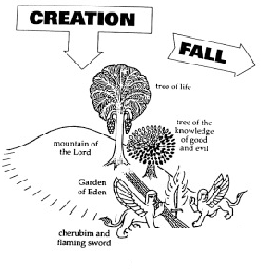
Notes:
-Creation occurred in Celestial realm
-Partook of Tree of Life Freely: walked and talked with God and had Eternal Life, lived in Terrestrial World.
-Partook of the Tree of Knowledge: separated from God, became carnal subject to death, driven from Eden and entered the Telestial world.
-Would need Redemption through a Savior to return to their previous relationship with God. They would have to work back into his presence tracing backwards through the same path as their the fall.

Slide 5
Celestial
Terrestrial
Telestial

Slide 6
Atonement: Redemption from the Fall
Mosiah 3:19 For the natural man is an enemy to God, and has been from the fall of Adam, and will be, forever and ever, unless he yields to the enticings of the Holy Spirit, and putteth off the natural man and becometh a saint through the atonement of Christ the Lord, and becometh as a child, submissive, meek, humble, patient, full of love, willing to submit to all things which the Lord seeth fit to inflict upon him, even as a child doth submit to his father.
Jesus Christ’s atoning sacrifice provided the only way for us to be cleansed and forgiven of our sins so that we can dwell in God’s presence eternally.” As 2 Nephi 2:8 puts it, “there is no flesh that can dwell in the presence of God, save it be through the merits, and mercy, and grace of the Holy Messiah.” - Christ is the Gatekeeper, he is in control of who receives redemption and salvation.
Notes:
What do we have that helps us understand the Redemption and process it takes to reverse the Fall?

Slide 7
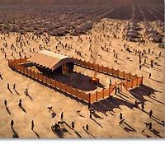

Slide 8
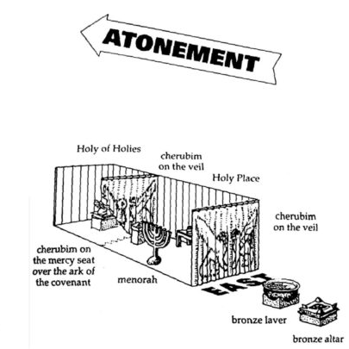
Moses’s Tabernacle:
-Laid out in the exact reverse of the fall of Adam and Eve in the Garden.
-Moses had already worked his way back into the presence of God through the Redemption of Christ. He tried to teach his people the same process yet they were unwilling to follow him.
-Building this tabernacle was a way for him to teach them how to symbolically return to the Presence of the Lord and he hoped they would understand the symbolism and act out the process as he did, in real life.
-Unfortunately, the majority of Jew saw this symbolism as their salvation. By the time Christ began teaching on the earth, the Jews believed this tabernacle or temple gave them salvation, missing the mark completely. Jews fully relied upon their priests and elders to guide them and were wholly unwilling to hear the Holy Spirit.

Slide 9
Celestial
Terrestrial
Baptism of Water
Baptism of Fire and the Holy Ghost
Telestial

Slide 10
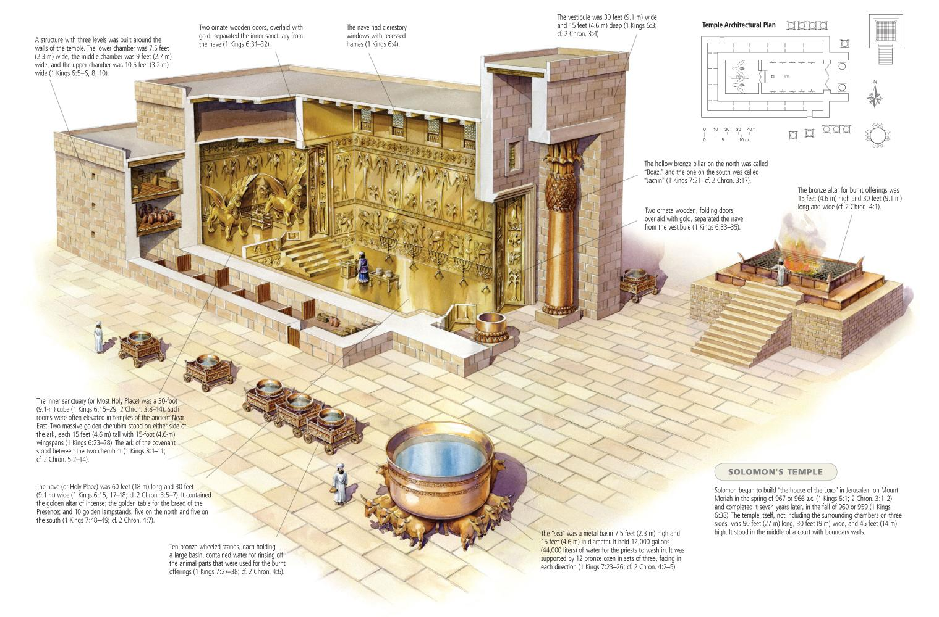

Slide 11
Doctrine and Covenants 22:2 Wherefore, although a man should be baptized an hundred times it availeth him nothing, for you cannot enter in at the strait gate by the law of Moses, neither by your dead works.

Slide 12
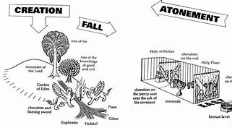

Slide 13
How does this Plan of Redemption play out in the lives of the Holy Prophets and People in the Scriptures?
Adam, King Benjamin’s People, Alma, Lehi, Abraham, Enos and Moses

Slide 14
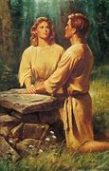
Adam and Eve

Slide 15
After being cast out, They must work their way back through the Atonement of Christ
Moses 5:4 And Adam and Eve, his wife, called upon the name of the Lord, and they heard the voice of the Lord from the way toward the Garden of Eden, speaking unto them, and they saw him not; for they were shut out from his presence.
5 And he gave unto them commandments, that they should worship the Lord their God, and should offer the firstlings of their flocks, for an offering unto the Lord. And Adam was obedient unto the commandments of the Lord.
6 And after many days an angel of the Lord appeared unto Adam, saying: Why dost thou offer sacrifices unto the Lord? And Adam said unto him: I know not, save the Lord commanded me. 8 Wherefore, thou shalt do all that thou doest in the name of the Son, and thou shalt repent and call upon God in the name of the Son forevermore.
9 And in that day the Holy Ghost fell upon Adam, which beareth record of the Father and the Son, saying: I am the Only Begotten of the Father from the beginning, henceforth and forever, that as thou hast fallen thou mayest be redeemed, and all mankind, even as many as will.
10 And in that day Adam blessed God and was filled, and began to prophesy concerning all the families of the earth, saying: Blessed be the name of God, for because of my transgression my eyes are opened, and in this life I shall have joy, and again in the flesh I shall see God.
Pattern:After receiving Knowledge and accepting his fallen state, he calls upon God for Salvation and is filled, receiving the Holy Ghost and can prophesy of all things. Heart is changed, has no more disposition to do evil.

Slide 16
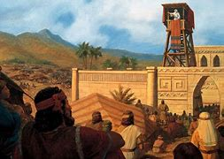
King Benjamin’s People

Slide 17
Pattern of Obedience and offering Sacrifice then receiving the Holy Ghost and Prophesying:
Mosiah 4: 1 And now...he cast his eyes round about on the multitude, and behold they had fallen to the earth, for the fear of the Lord had come upon them. 6 …. ye have come to a knowledge of the goodness of God,
2 And they had viewed themselves in their own carnal state, even less than the dust of the earth. And they all cried aloud with one voice, saying: O have mercy, and apply the atoning blood of Christ that we may receive forgiveness of our sins, and our hearts may be purified; for we believe in Jesus Christ, the Son of God, who created heaven and earth, and all things; who shall come down among the children of men. 3 And it came to pass that after they had spoken these words the Spirit of the Lord came upon them, and they were filled with joy, having received a remission of their sins, and having peace of conscience, because of the exceeding faith which they had in Jesus Christ who should come, according to the words which king Benjamin had spoken unto them.

Slide 18
6. The atonement which has been prepared from the foundation of the world, that thereby salvation might come to him that should put his trust in the Lord, and should be diligent in keeping his commandments, and continue in the faith even unto the end of his life, I mean the life of the mortal body—7 I say, that this is the man who receiveth salvation, through the atonement which was prepared from the foundation of the world for all mankind, which ever were since the fall of Adam, or who are, or who ever shall be, even unto the end of the world.8 And this is the means whereby salvation cometh. And there is ªnone other salvation save this which hath been spoken of; neither are there any conditions whereby man can be saved except the conditions which I have told you.
Mosiah -5:2 Yea, we believe all the words which thou hast spoken unto us; and also, we know of their surety and truth, because of the Spirit of the Lord Omnipotent, which has wrought a mighty change in us, or in our hearts, that we have no more disposition to do evil, but to do good continually. 3 And we, ourselves, also, through the infinite goodness of God, and the manifestations of his Spirit, have great views of that which is to come; and were it expedient, we could prophesy of all things.

Slide 19
These were good people who attended the temple and had performed all the ordinances needed, according to their understanding. Yet, they had not been redeemed nor did they have sufficient knowledge to receive the Baptism of Fire and Gift of the Holy Ghost to enter back into the presence of the Lord. King Benjamin understood this after an Angel taught him. 3:2 And the things which I shall tell you are made known unto me by an angel from God. And he said unto me: Awake; and I awoke, and behold he stood before me.
This Angel gave him specific knowledge needed to then administer truth to his people. Just as the Angel gave knowledge to Adam and helped bring Adam to receive the Holy Ghost and be able to prophesy of all things.
- Pattern: Moses 5:58 And thus the Gospel began to be preached, from the beginning, being declared by holy angels sent forth from the presence of God, and by his own voice, and by the gift of the Holy Ghost.

Slide 20
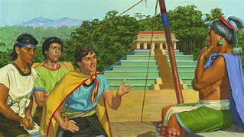
Aaron teaches Lamoni’s Father

Slide 21
Another example of this pattern is in Alma
Alma 22:12 And it came to pass that when Aaron saw that the king would believe his words, he began from the creation of Adam, reading the scriptures unto the king—how God created man after his own image, and that God gave him commandments, and that because of transgression, man had fallen.
13 And Aaron did expound unto him the scriptures from the creation of Adam, laying the fall of man before him, and their carnal state and also the plan of redemption, which was prepared from the foundation of the world, through Christ, for all whosoever would believe on his name.
14 And since man had fallen he could not merit anything of himself; but the sufferings and death of Christ atone for their sins, through faith and repentance, and so forth; and that he breaketh the bands of death, that the ^{e}grave shall have no victory, and that the sting of death should be swallowed up in the hopes of glory; and Aaron did expound all these things unto the king.
15- What shall I do that I may have this eternal life of which thou hast spoken? Yea, what shall I do that I may be born of God, having this wicked spirit rooted out of my breast, and receive his Spirit, that I may be filled with joy, that I may not be cast off at the last day? Behold, said he, I will give up all that I possess, yea, I will forsake my kingdom (this was his Abrahamic Sacrifice), that I may receive this great joy. 16- If thou desirest this thing, if thou wilt bow down before God, yea, if thou wilt repent of all thy sins, and will bow down before God, and call on his name in faith, believing that ye shall receive, then shalt thou receive the hope which thou desirest.
18 O God, Aaron hath told me that there is a God; and if there is a God, and if thou art God, wilt thou make thyself known unto me, and I will give away all my sins to know thee, and that I may be raised from the dead, and be saved at the last day. And now when the king had said these words, he was struck as if he were dead.

Slide 22
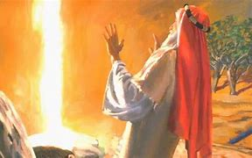
Lehi

Slide 23
Example of Lehi:
4...(my father, Lehi, having dwelt at Jerusalem in all his days); and in that same year there came many prophets, prophesying unto the people that they must repent, or the great city Jerusalem must be destroyed.
5 Wherefore it came to pass that my father, Lehi, as he went forth prayed unto the Lord, yea, even with all his heart, in behalf of his people.
6 And it came to pass as he prayed unto the Lord, there came a pillar of fire and dwelt upon a rock before him; and he saw and heard much; and because of the things which he saw and heard he did quake and tremble exceedingly.
8 And being thus overcome with the Spirit, he was carried away in a ªvision, even that he saw the heavens open, and he thought he saw God sitting upon his throne, surrounded with numberless concourses of angels in the attitude of singing and praising their God.---Lehi then sees Christ descending with the 12 Disciples and is given a book---12 And it came to pass that as he read, he was filled with the Spirit of the Lord.
15 And after this manner was the language of my father in the praising of his God; for his soul did rejoice, and his whole heart was filled, because of the things which he had seen, yea, which the Lord had shown unto him.
2:2 And it came to pass that the Lord commanded my father, even in a dream, that he should take his family and depart into the wilderness.
Dream : Tree of Life

Slide 24
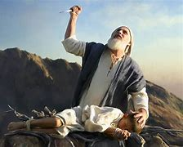
Abraham

Slide 25
Abraham
1...I, ^{b}Abraham, saw that it was needful for me to obtain another place of residence;
2 And, finding there was greater happiness and peace and rest for me, I sought for the blessings of the fathers
, and the right whereunto I should be ordained to administer the same; having been myself a follower of righteousness, desiring also to be one who possessed great knowledge, and to be a greater follower of righteousness, and to possess a greater knowledge, and to be a father of many nations, a prince of peace, and desiring to receive instructions, and to keep the commandments of God, I became a rightful heir, a High Priest, holding the right belonging to the fathers.
3 It was conferred upon me from the fathers it came down from the fathers, from the beginning of time, yea, even from the beginning, or before the foundation of the earth, down to the present time, even the right of the firstborn, or the first man, who is Adam, or first father, through the fathers unto me.
4 I sought for mine appointment unto the Priesthood according to the appointment of God unto the fathers concerning the seed.
5 My fathers, having turned from their righteousness, and from the holy commandments which the Lord their God had given unto them, unto the worshiping of the gods of the ^{c}heathen, utterly refused to hearken to my voice;
15...I lifted up my voice unto the Lord my God, (Calls upon God for salvation) and the Lord hearkened and heard, and he filled me with the vision of the Almighty, and the angel of his presence stood by me, and immediately unloosed my bands;

Slide 26
31 But the records of the fathers, even the patriarchs, concerning the right of Priesthood, the Lord my God preserved in mine own hands; therefore a knowledge of the beginning of the creation, and also of the planets, and of the stars, as they were made known unto the fathers, have I kept even unto this day..
2:3 Now the Lord had said unto me: Abraham, get thee out of thy country, and from thy kindred, and from thy father’s house, unto a land that I will show thee.

Slide 27
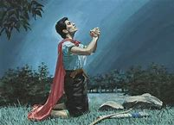
Enos

Slide 28
1 Behold, it came to pass that I, Enos, knowing my father that he was a just man—for he taught me in his language, and also in the nurture and admonition of the Lord—and blessed be the name of my God for it. 2 And I will tell you of the wrestle which I had before God, before I received a remission of my sins.
5 And there came a voice unto me, saying: Enos, thy sins are forgiven thee, and thou shalt be blessed.
8… Because of thy faith in Christ, whom thou hast never before heard nor seen. And many years pass away before he shall manifest himself in the flesh; wherefore, go to, thy faith hath made thee whole.
26...by the power of God that I must preach and prophesy unto this people, and declare the word according to the truth which is in Christ. And I have declared it in all my days, and have rejoiced in it above that of the world.

Slide 29
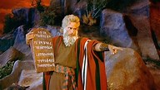
Moses

Slide 30
Moses accomplished this process:
-Moses must be taught all things from the beginning: Creation, Fall, Redemption He Receives greater knowledge causing him to act to progress. Moses 1:8 And it came to pass that Moses looked, and beheld the ªworld upon which he was created; and Moses ^{b}beheld the world and the ends thereof, and all the children of men which are, and which were created; of the same he greatly ^{c}marveled and wondered.
9 ... Now, for this cause I know that ^{b}man is ^{c}nothing, which thing I never had supposed.
-----Teaching Israelites------
68 Behold, thou art ªone in me, a son of God; and thus may all become my ^{b}sons. Amen.
Duet 5:5 (I stood between the Lord and you at that time, to shew you the word of the Lord: for ye were afraid by reason of the fire, and went not up into the mount;)24 And ye said, Behold, the Lord our God hath shewed us his glory and his greatness, and we have heard his voice out of the midst of the fire: we have seen this day that God doth talk with man, and he liveth. 25 Now therefore why should we die? for this great fire will consume us: if we hear the voice of the Lord our God any more, then we shall die. 27 Go thou near, and hear all that the Lord our God shall say: and speak thou unto us all that the Lord our God shall speak unto thee; and we will hear it, and do it.

Slide 31
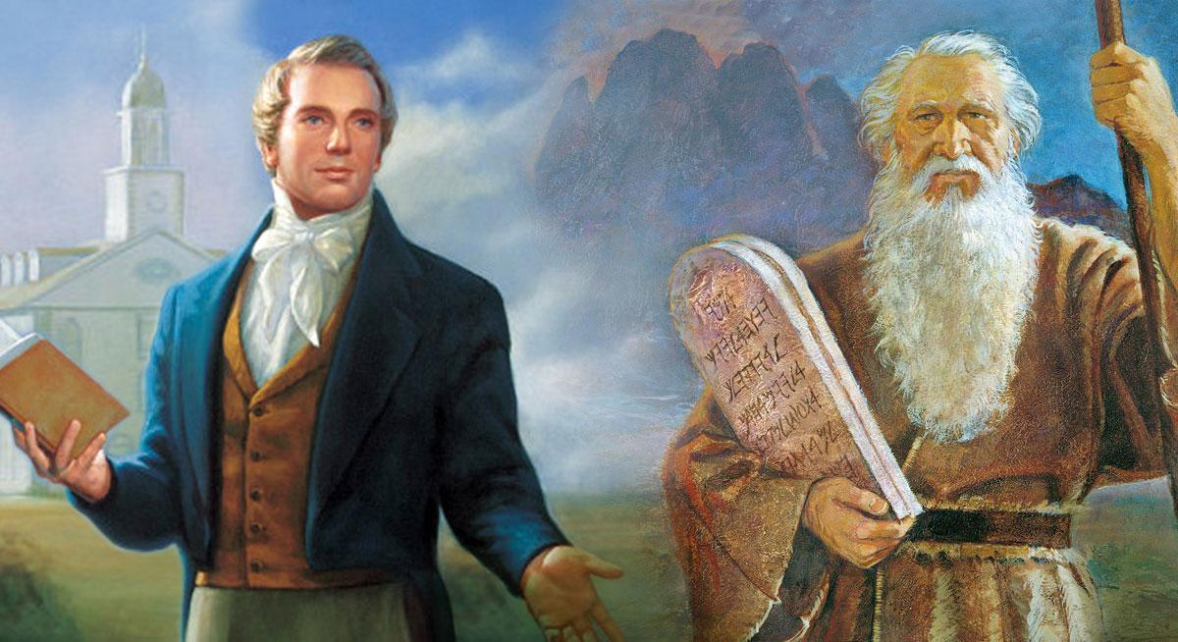

Slide 32
Moses 1:41 And in a day when the children of men shall esteem my words as naught and take many of them from the book which thou shalt write, behold, I will raise up another like unto thee; and they shall be had again among the children of men, among as many as shall believe.
2 Nephi 3:7,9A choice seer will I raise up out of the fruit of thy loins; and he shall be esteemed highly among the fruit of thy loins.... And he shall be great like unto Moses,
D&C 28:2 But, behold, verily, verily, I say unto thee, no one shall be appointed to receive commandments and revelations in this church excepting my servant Joseph Smith, Jun., for he receiveth them even as Moses.
107:91 91 And again, the duty of the President of the office of the High Priesthood is to preside over the whole church, and to be like unto Moses—

Slide 33
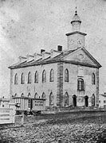

Slide 34
Doctrine of Christ: The Same Yesterday, Today and Forever
2 Nephi 31:2 Wherefore, the things which I have written sufficeth me, save it be a few words which I a must speak concerning the doctrine of Christ; ..13,, yea, by following your Lord and your Savior down into the water, according to his word, behold, then shall ye receive the Holy Ghost; yea, then cometh the baptism of fire and of the Holy Ghost; and then can ye speak with the tongue of angels, and shout praises unto the Holy One of Israel.
2 nephi 31:17.. that ye might know the gate by which ye should enter. For the gate by which ye should enter is repentance and baptism by water; and then cometh a remission of your sins by fire and by the Holy Ghost
2 Nephi 31:21 And now, behold, my beloved brethren, this is the away; and there is none other way nor name given under heaven whereby man can be saved in the kingdom of God. And now, behold, this is the doctrine of Christ, and the only and true doctrine of the Father, and of the Son, and of the Holy Ghost, which is one God, without end. Amen.
2 Nephi 32:5-6 For behold, again I say unto you that if ye will enter in by the way, and receive the Holy Ghost, it will show unto you all things what ye should do. 6 Behold, this is the doctrine of Christ, and there will be no more doctrine given until after he shall a manifest himself unto you in the flesh. And when he shall manifest himself unto you in the flesh, the things which he shall say unto you shall ye observe to do.
3 Nephi 11: 40 And whoso shall declare more or less than this, and establish it for my doctrine, the same cometh of evil, and is not built upon my rock;

Slide 35
2 Nephi 31:13 Wherefore, my beloved brethren, I know that if ye shall ªfollow the Son, with full purpose of heart, acting no ^{b}hypocrisy and no deception before God, but with real ^{c}intent, repenting of your sins, witnessing unto the Father that ye are ^{d}willing to take upon you the ^{e}name of Christ, by ^{f}baptism—yea, by following your Lord and your Savior down into the water, according to his word, behold, then shall ye receive the Holy Ghost; yea, then cometh the ^{g}baptism of fire and of the Holy Ghost; and then can ye speak with the ^{h}tongue of angels, and shout praises unto the Holy One of Israel.

Slide 36
2 Nephi 2:
6 Wherefore, ªredemption cometh in and through the ^{b}Holy ^{c}Messiah; for he is full of ^{d}grace and truth.
7 Behold, he offereth himself a ªsacrifice for sin, to answer the ends of the law, unto all those who have a broken heart and a contrite spirit; and unto ^{b}none else can the ^{c}ends of the law be answered.

Slide 37
Respected Uncle Silas:—¹ It is with feelings of deep interest for the welfare of mankind² which fill my mind on the reflection that all were formed by the hand of Him who will call the same to give and an impartial account of all their works in that great day to which you and myself in common with them are bound, that I take up my pen and seat myself in an attitude to address a few though imperfect lines to you for your perusal.³
I have no doubt but you will agree with me that men will be held accountable for the things they have, and not for the things they have not, or, that all the light and intelligence communicated to them from their Beneficent Creator, whether it is much or little, by the same they in justice will be judged; and that they are required to yield obedience to,⁴ and improve upon that, and that only, which is given;⁵ for man is not to live by bread alone, but by every word that proceeds out of the mouth of the Lord.⁶
Seeing that the Lord has never [p. 2] given them⁷ to understand by anything heretofore revealed that He had ceased to speak, forever, to his creatures, when sought unto in a proper manner, why should it be thought a thing incredible that He should be pleased to speak again, in these last days for their salvation?⁸
Perhaps you may be surprised at this assertion. That I should say for the salvation of his creatures in these last days, since we have already in our possession a vast volume of his word, which he has previously given
But you will admit that the word spoken to Noah was not sufficient for Abraham, or it was not required of <​him​>⁹ to leave the land of his nativity, and seek an inheritance in a strange country upon the word spoken to Noah, but, for himself he obtained promises from the hand of the Lord, and walked in that perfection¹⁰ that he was called the friend of God.¹¹
Isaac, the promised seed, was not required to rest his hope alone¹² upon the promises made to his father Abraham, but was privileged with the assurance of his approbation in the sight of Heaven, by the direct voice of the Lord to him.¹³
If one man can live upon the revelations¹⁴ to another,¹⁵ might I not with propriety ask, why the necessity then, of the Lord’s speaking to Isaac as he did, as is recorded in the twenty sixth chapter of Genesis? For the Lord there repeats, or rather, promises again to perform the oath which he had previously sworn to Abraham,¹⁶ and why this repetition to Isaac? Why was not the first promise as sure for Isaac as it was for Abraham? Was not Isaac Abraham’s son, and could he not place implicit confidence in the veracity of his father as <​being​> a man of God?
Perhaps you may say that he was a very peculiar man, and different from men in these last days, consequently the Lord favored him with blessings, peculiar and different, as he was different from men in this age.
I admit that he was a peculiar man, and was not only peculiarly blessed, but greatly blessed.
But all the peculiarity that I can discover in the man, or all the difference between him and men in this age, is, that he was more holy and more perfect before God, and came to Him with a purer heart, and more faith than men in this day.
The same might be said on the subject of Jacob’s history. Why was it that the Lord spake to him concerning the same promise, after He had made it once to Abraham, and renewed it to Isaac? Why could not Jacob rest contented upon the word spoken to his fathers?¹⁷ When the time of the promise drew nigh for the deliverance of the children of Israel from the land of [p. 3] Egypt, why was it necessary that the Lord should begin to speak to them?
The promise or word to Abraham, was, that his seed should serve in bondage, and be afflicted, four hundred years, and after that they should come out with great substance.¹⁸ Why did they not rely upon this promise, and when they had remained in Egypt, in bondage, four hundred years, come out, without waiting for further revelations,¹⁹ but act entirely upon the promise given to Abraham that they should come out?
Paul said to his Hebrew brethren, that God might more abundantly show²⁰ unto the heirs of promise the immutability of His counsel, He confirmed it by an oath.²¹ He also exhorts them, who, through faith and patience inherit the promises.
Notwithstanding, we (said Paul) have fled for refuge to lay hold upon the hope set before us, which hope we have as an anchor to the soul, both sure and stedfast, and which entereth into that within the vail,²² yet he was careful to press upon them the necessity of continuing on until they, as well as those who then²³ inherited the promises, might have the assurance of their salvation confirmed to them, by an oath from the mouth of Him who could not lie; for that seemed to be the example anciently, and Paul holds it out to his Hebrew brethren as an object attainable in his day.
And why not? I admit that by reading the Scriptures of truth the Saints, in the days of Paul, could learn, beyond the power of contradiction, that Abraham, Isaac, and Jacob, had the promise of eternal life confirmed to them by an oath of the Lord, but that promise or oath was <​no​> assurance to them of their salvation; but they could by walking in the footsteps and continuing in the faith of their fathers, obtain, for themselves an oath for confirmation that they were meet to be partakers of the inheritance, with the Saints in light.
If the Saints in the days of the Apostles were priviledged to take the Ancients²⁴ for examples,²⁵ and lay hold of the same promises, and attain to the same exalted privilege of knowing that their names were written in the Lamb’s Book of Life²⁶ and that they were sealed there as a perpetual memorial before the face of the Most High, will not the same faithfulness, the same purity of heart and the same Faith, bring the same assurance of eternal life, and that in the same manner, to the children of men now in this age of the world? I have no doubt but that the holy Prophets and Apostles and [p. 4] Saints in ancient days, were saved in the Kingdom of God; neither do I doubt but that they held converse and communion with Him²⁷ while they were in the flesh, as Paul said to his Corinthian brethren that the Lord Jesus showed Himself to above five hundred Saints at one time after His resurrection.²⁸ Job said that he knew that his Redeemer lived and that he should see Him in the flesh in the latter days.²⁹ I may believe that Enoch walked with God and by faith was translated.³⁰ I may believe that Noah was a perfect man in his generation and also walked with God.³¹ I may believe that Abraham communed with God and conversed with angels.³² I may believe that Isaac obtained a renewal of the covenant made to Abraham by the direct voice of the Lord.³³ I may believe that Jacob conversed with holy angels, and heard the voice³⁴ of his Maker, that he wrestled with the angel until he prevailed and obtained the blessing.³⁵ I may believe that Elijah was taken to Heaven in a chariot of fire with fiery horses.³⁶ I may believe that the saints saw the Lord and conversed with Him face to face after His resurrection.³⁷ I may believe that the Hebrew Church came to Mount Zion, and unto the city of the Living God the Heavenly Jerusalem, and to an innumerable company of angels. I may believe that they looked into eternity, and saw the Judge of all, and Jesus the Mediator of the New Covenant.³⁸ But will all this purchase an assurance for me, and³⁹ waft me to the regions of eternal day and seat me down in the presence of the King of Kings⁴⁰ with my garments spotless pure and white?
Or must I not rather obtain for myself by my own faith and diligence in keeping the commandments of the Lord, an assurance of salvation for myself? And have I not an equal privilege with the ancient Saints? And will not the Lord hear my prayers and listen to my cries as soon as he ever did to theirs, if I come to him in the manner they did? Or, is he a respecter of persons?⁴¹
So I must close this subject for want of time, and I may with propriety say at the beginning
We would be glad⁴² to see you in Kirtland, we would be glad to see you embrace⁴³ the New Covenant and be one with us, we sometimes think you are now one with us in heart.⁴⁴
I remain yours affectionately
Joseph Smith Jun

